Slide 1
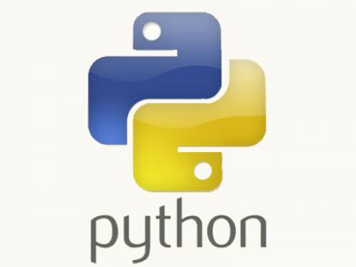
Python Training.....
-- Jeetendra Bhattad

Slide 2
Agenda
Iterators
Iterator User Defined Class / Objects
Generators
Assignments

Slide 3
Iterators
Iterators are objects which support iteration.
Iterator objects must have next & __iter__ methods.
__iter__ should return the iterator itself.
next should return the next element & raise StopIteration when finished.
Any sequence can be turned into an iterator using the built-in function iter.

Slide 4
Simple Iterator Example
#!/usr/bin/python
def main(x):
i = iter(range(x))
print (next(i))
print (next(i))
print (next(i))
print (next(i))
#boiler-plate
if __name__ == "__main__":
main(5)

Slide 5
Making Class-Object's Iterable
#!/usr/bin/python
class AutoGenerate:
def __init__(self, start, end, step=1):
self.start = start
self.end = end
self.step = step
def next(self):
self.start += self.step
if self.start >= self.end:
raise StopIteration
return self.start
def __iter__(self):
return self
def main():
x = AutoGenerate(0, 100, 5)
#for y in x:
# print y
z = iter(x)
print(next(z))
print(next(z))
print(next(z))
if __name__ == "__main__":
main()

Slide 6
Iterators : yeild -> Generators
Yield : implies transfer of control is temporary & voluntary and function expects to get control again.
Generators are simple functions which returns an Object on which next() can be invoked, such that every call returns some value and should raise StopIteration exception when done.
#!/usr/bin/python
def SampleGenerator():
yield 1
yield 2
yield 3
if __name__ == "__main__":
for x in SampleGenerator():
print (x)

Slide 7
Generators
#!/usr/bin/python
import re
def GeneratorGrep(pattern, file_name):
fd = open(file_name)
pat = re.compile(pattern)
for line in fd:
if pat.search(line):
yield line
fd.close()
def main():
file_name = input("Enter File Name from which to extract single line comments:")
comment_line_generator = GeneratorGrep("\A#", file_name)
for line in comment_line_generator:
print(line)
if __name__ == "__main__":
main()

Slide 8
Decorators
It provides a very useful way to add additional functionality to existing functions and classes.
They are functions that wrap other functions or classes.
In simple terms it is a way to dynamically add new behavior to some objects.

Slide 9
Decorators
#!/usr/bin/python
def InitGenerator(func):
def initialize(*args, **kwargs):
gen = func(*args, **kwargs)
next(gen)
return gen
return initialize
def ToUpper():
while True:
string = yield # coroutines
print(string.upper())
@InitGenerator
def ToUpperDecorated():
while True:
string = yield
print(string.upper())

